Slide 1
Data Sheet - 16x2 LCD Interfacing
Dr.Sreejith Rajan

Slide 2
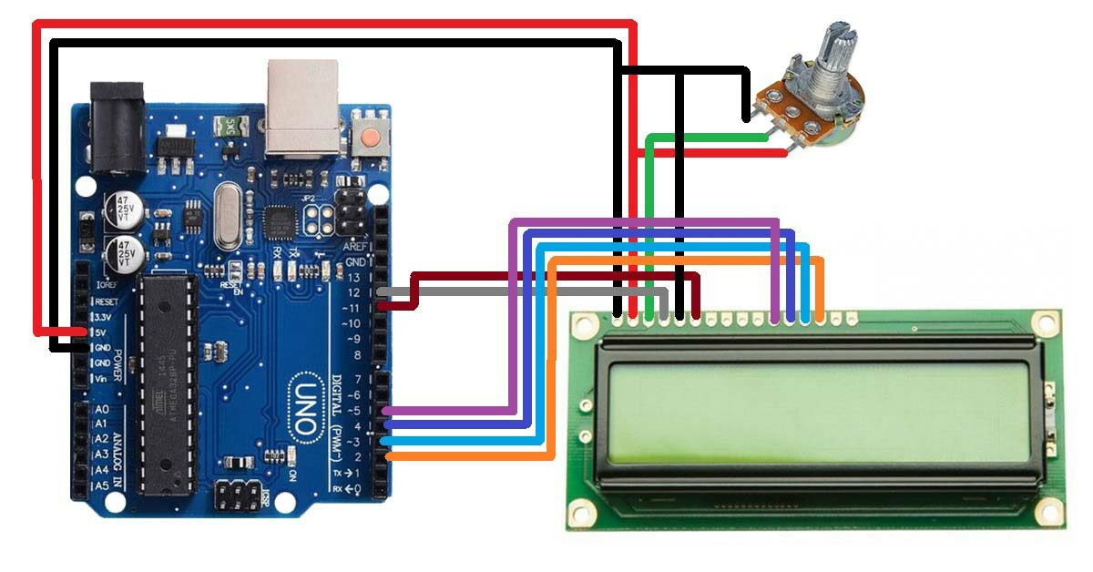
Interfacing 162A with Arduino

Slide 3
JHD-162
We are going to implement a few functions for JHD162A
LCD Initialisation
LCD Enable pulse
Set Cursor
Send Nibble
Send Byte
Print String
Print Values etc
1

Slide 4
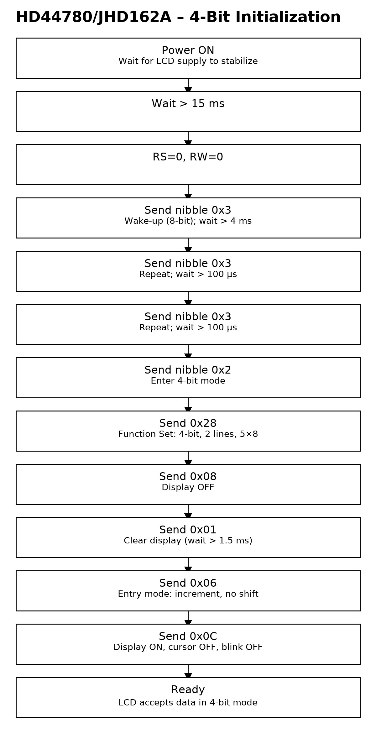
Flow Charts -Initialisation
1

Slide 5
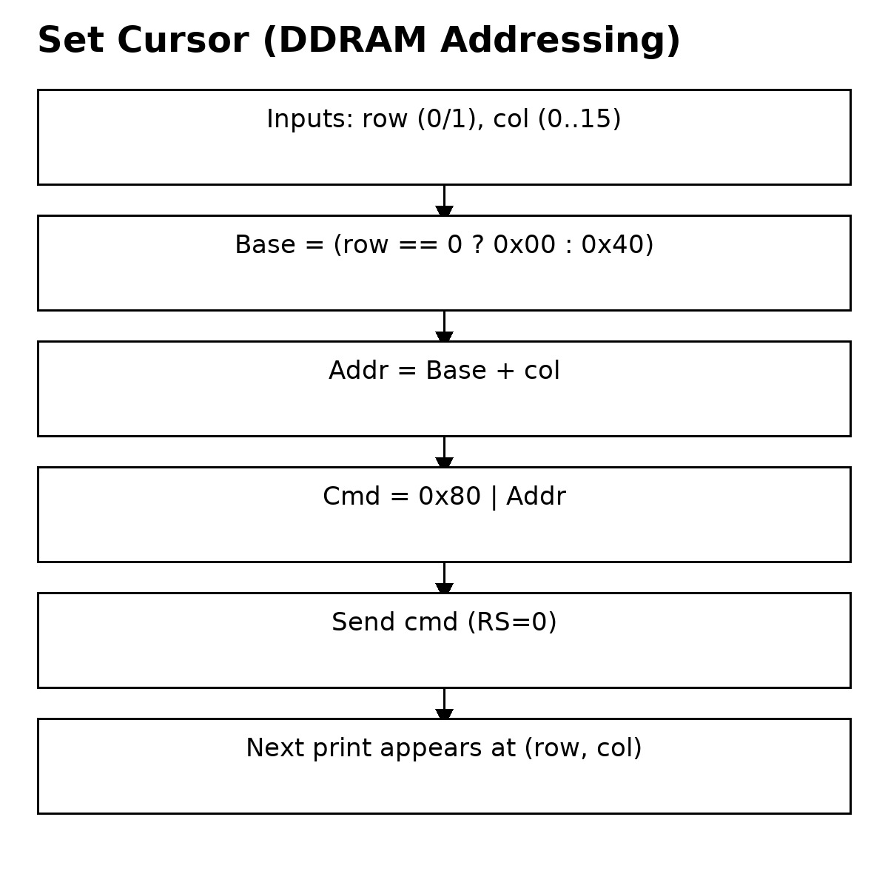
Flow Charts –Set Cursor
1

Slide 6
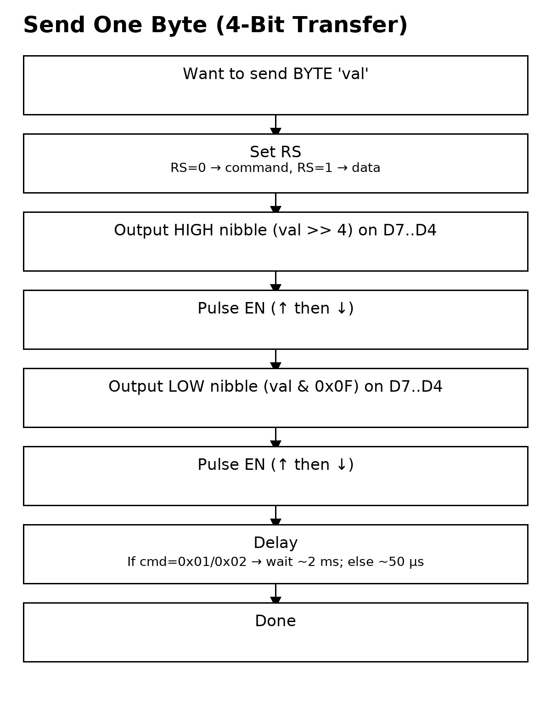
Flow Charts –Send Byte
1

Slide 7
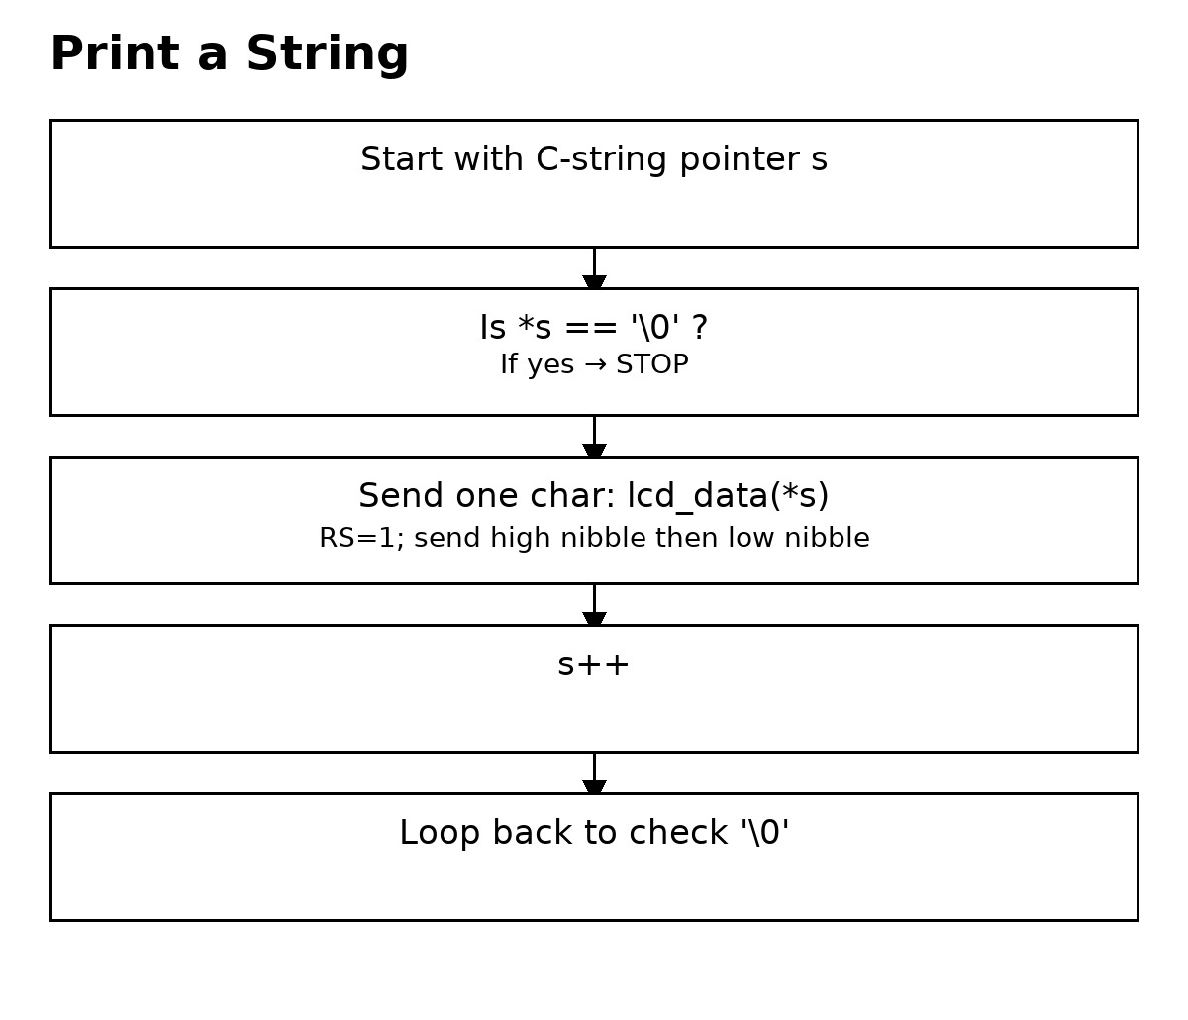
Flow Charts –Print String
1

Slide 8
THANK YOU

